Slide 1
Establish connection to AL13xx & AL19xx via LR Device English

Slide 2
Contents:
Connect units
LR Device - Find AL1330

Slide 3
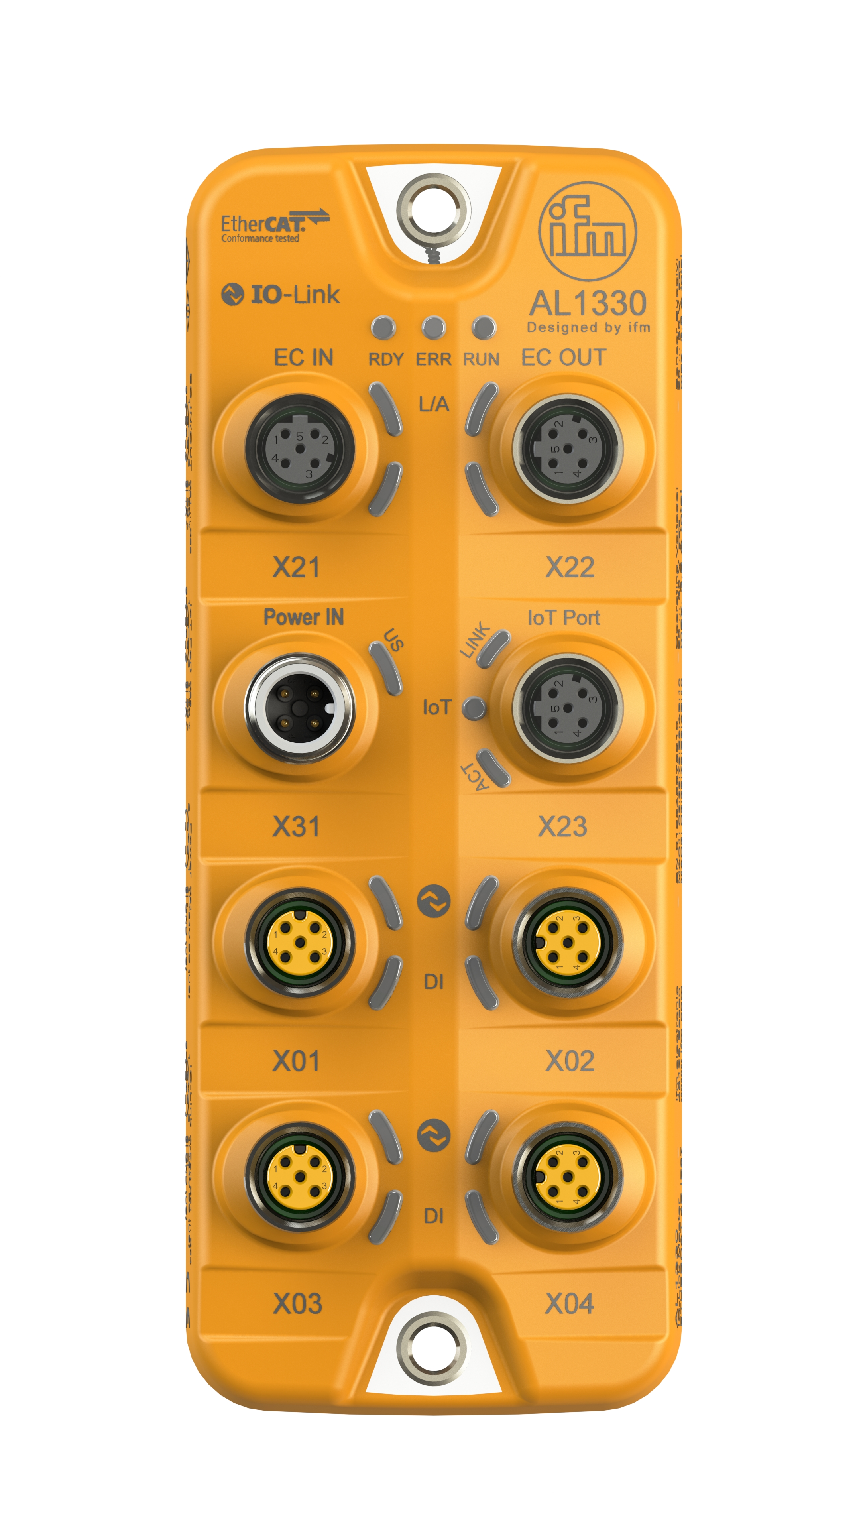
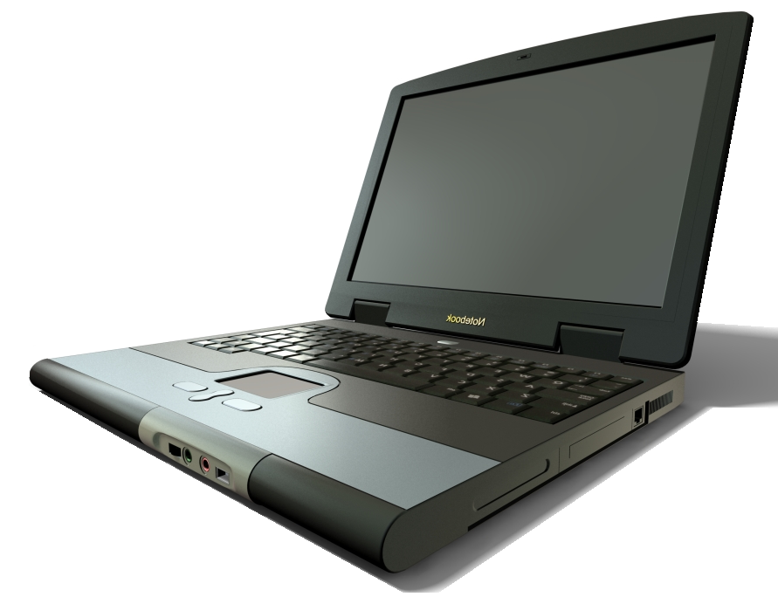
Connect units
Laptop / PC
with LR Device
QA0011 / QA0012
IO-Link Master
EtherCAT Device
AL1330

Slide 4
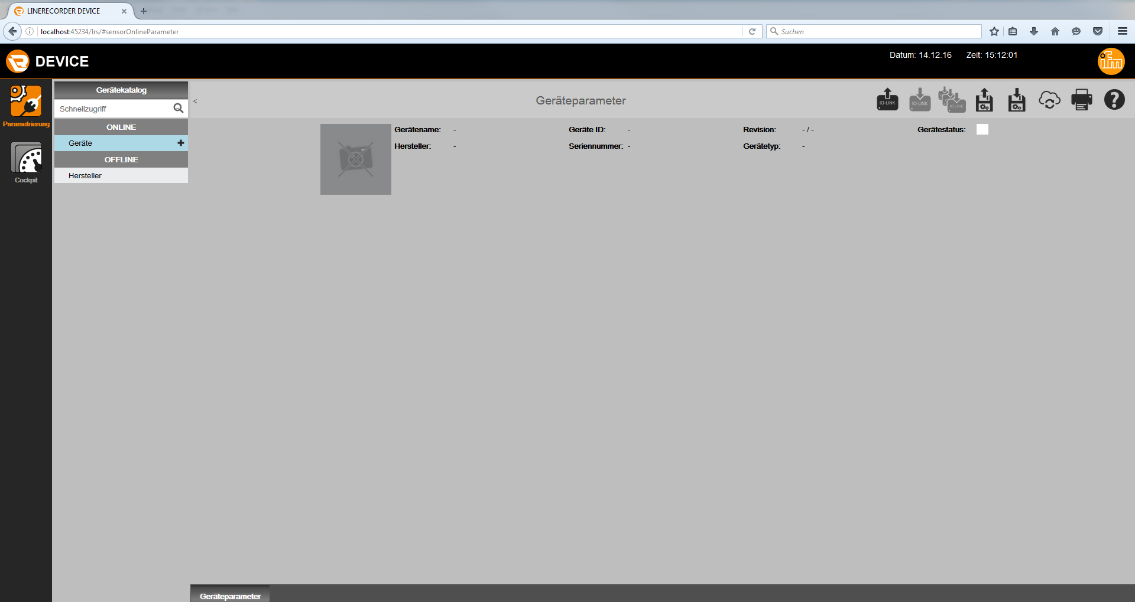
2. LR Device – Find AL1330
Open LR Device software
Click at ‚Devices‘
Click at ‚Read
from devices‘

Slide 5
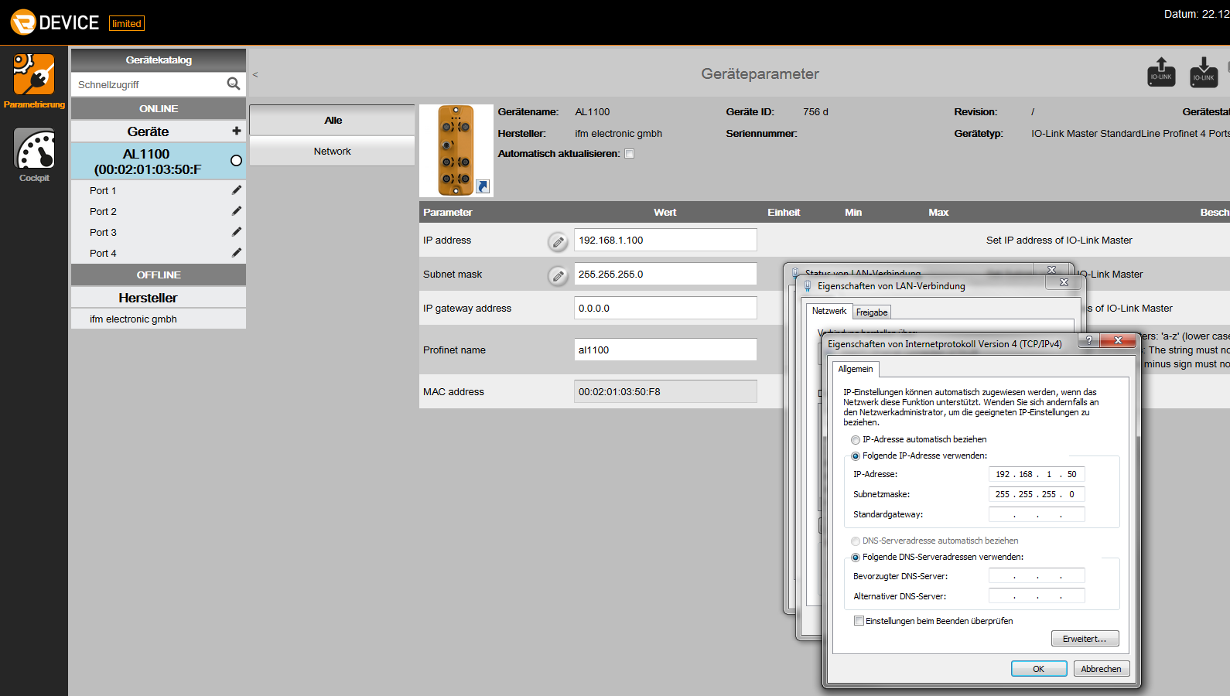
2. LR Device – Find AL1330
Set IP-addresses – DCP connection
Set your IP-address and netmask to same area as the AL
Click at ‚Write to
device‘

Slide 6
2. LR Device – Find AL1330
Establish TCP/IP connection
Click at ‚Devices‘
Click at ‚Read
from devices‘

Slide 7
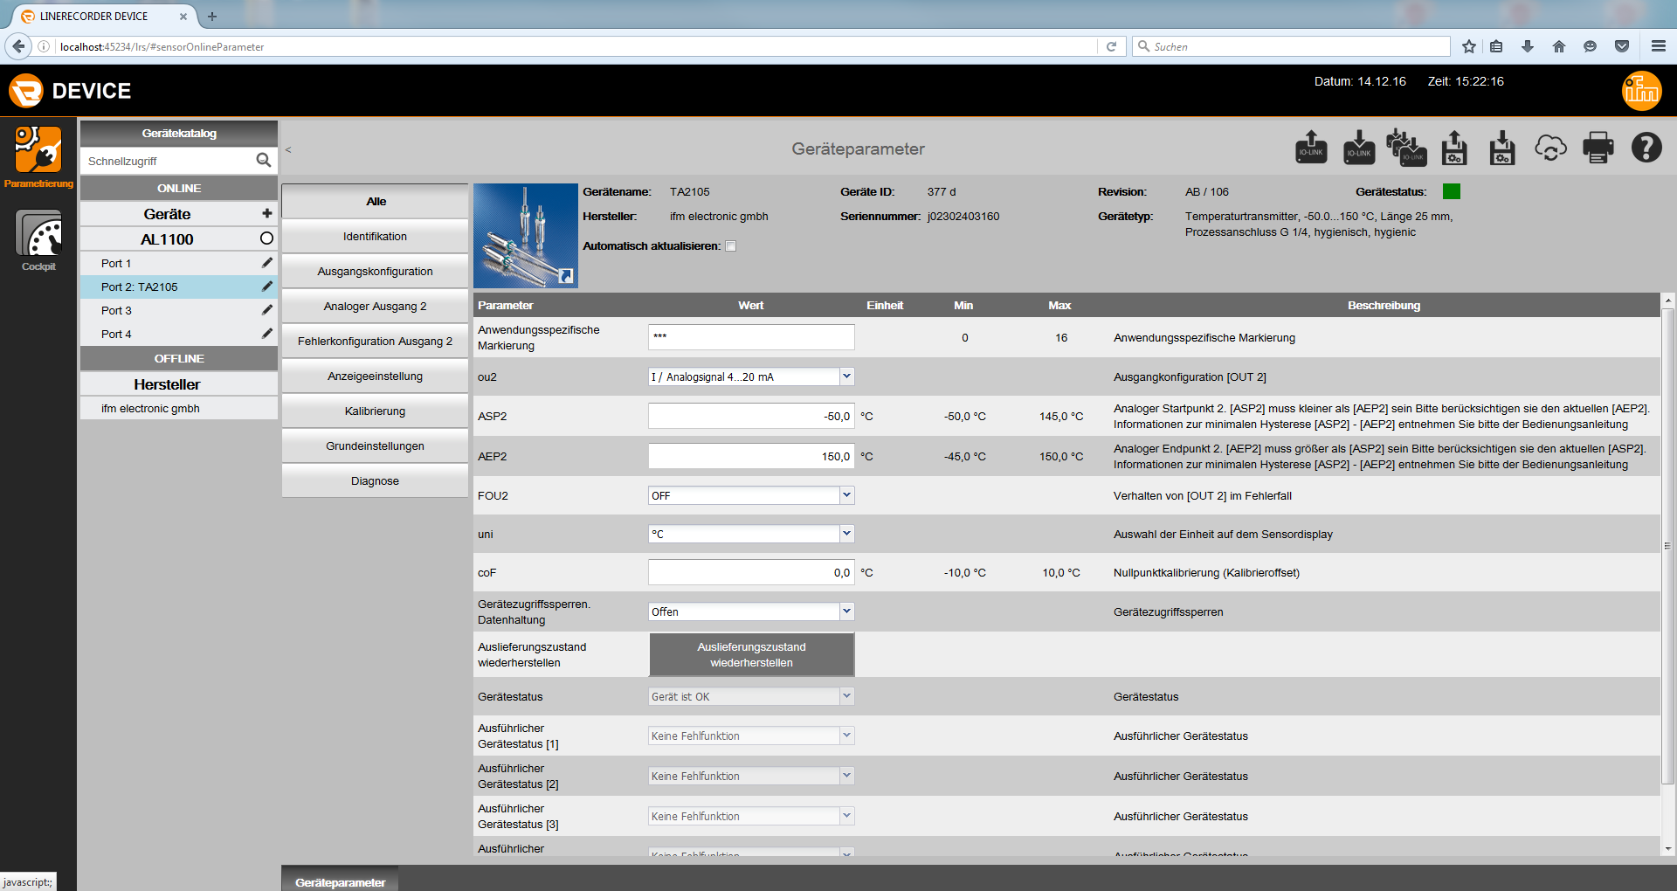
2. LR Device – Find AL1330
TCP/IP connection to AL1330
Now you get a TCP/IP connection and see your connected devices

